Slide 1

Airbnb Analysis
Name – Shishir Kherod
Group 4
ABADS Batch 11

Slide 2
Objective:
The task is to generate an ML based solution that can be used to suggest appropriate listing prices to the property owner when they try to list a property out for rent.
To analyze the attributes and find the relation of those attributes with the target variable i.e. price of the properties.

Slide 3
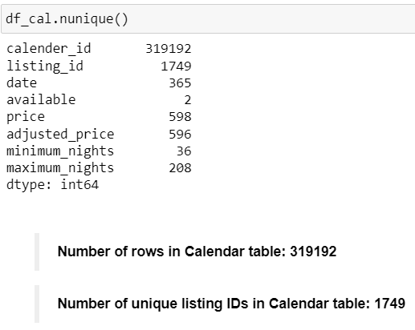
Data Understanding and feature creation (Task 1):
Look at the table Calendar how many rows and unique listing ids are present? Are there any implications when it comes to having more rows and less unique listing ids?
Having more rows means there are more individual entries in the dataset, which could potentially provide more detailed information about bookings over time.
Having fewer unique listing IDs relative to the number of rows could imply either multiple bookings for the same listing or listings being available for different periods, which could affect certain analyses, such as occupancy rates or pricing strategies.

Slide 4
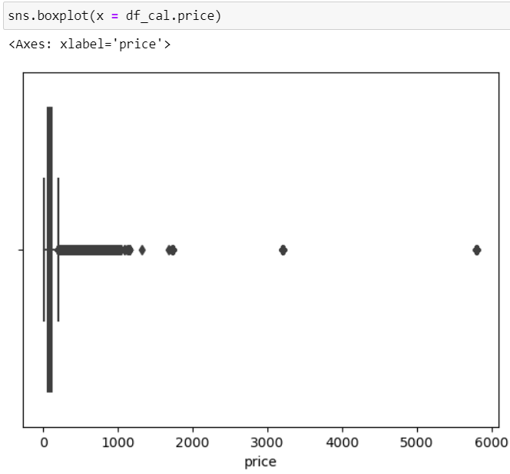
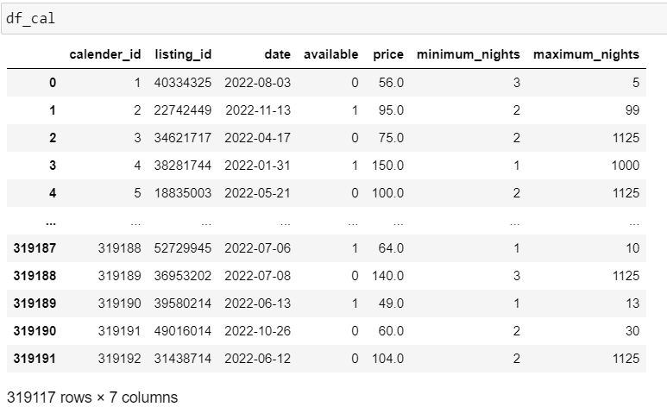
Data Understanding and feature creation (Task 1):
Look at the price column in Calendar table. What transformations you will need to perform so that you can create a column that can be used as a target/response variable?
To prepare the price column in the Calendar table to be used as a target/response variable, we need to perform several transformations:
Data Type Conversion: Ensure that the price column is in numeric format (e.g., float or integer) rather than a string/object type.
Handling Missing Values: Check for missing values in the price column and decide on a strategy to handle them, such as imputation with the mean, median, or a specific value, or removing rows with missing prices if appropriate.
Outlier Detection and Removal: Identify and handle outliers in the price column using boxplot. Extreme prices may distort the model's predictions, so it's essential to address them appropriately, either by removing them or transforming them.
Dropped the missing values in price column as they were very less i.e. 75 and also dropped the adjusted_price column.

Slide 5
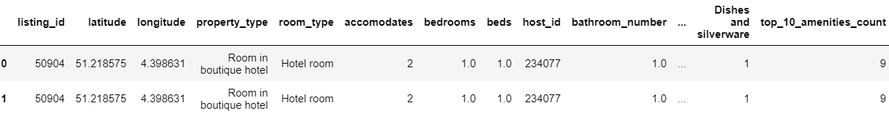
Data Understanding and feature creation (Task 1):
Look at the tables Listings, Hosts and Reviews to come up with a list of potential transformations needed in order to have predictors that can be used to predict the listing price.
Separating the amenities column into top 10 most provided amenities, including separate column for number of maximum amenities provided in property out of 10 and checking which property is providing most of them:
In the process of merging the data from df_listings, df_cal, and df_hosts, the decision was made to exclude the df_reviews table for the following reasons:
Data Size and Complexity: The inclusion of df_reviews significantly increases the volume of data due to its many-to-many relationship with df_listings. This can lead to a substantial increase in the number of rows in the merged dataset, making it more challenging to manage and analyze efficiently.
Focus on Key Attributes: The primary objective of merging df_listings, df_cal, and df_hosts was to consolidate essential information related to property listings, availability, and host details. These attributes are crucial for pricing analysis, market trends, and host behavior insights.
Avoiding Data Redundancy: By excluding df_reviews, we mitigate the risk of duplicating calendar_id values across multiple review entries.
In summary, by not merging the df_reviews table into the consolidated dataset, we ensure a more focused, manageable, and analytically clear dataset for comprehensive analysis of property listings, availability trends, and host dynamics.

Slide 6
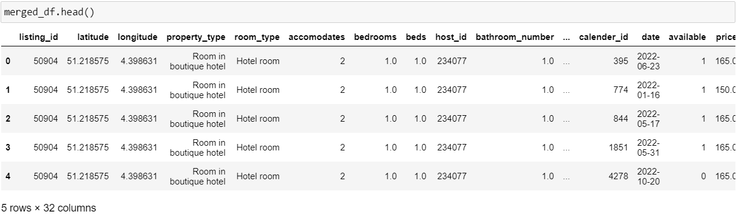
Data Understanding and feature creation (Task 1):
Create an aggregated view of data spread across different tables, containing the target as well as predictor variables.

Slide 7
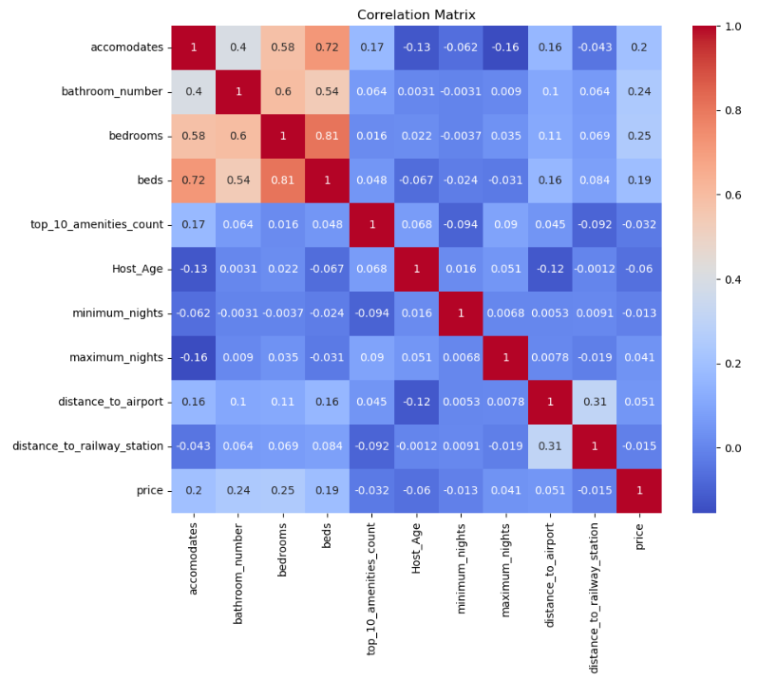
Variable profiling and checking relationships between variables (Task 2):
Assess the relationship between target and predictor variables. You can compute correlations, plot bivariate relationships
Plot heat map of correlations between Numerical Variable
Price Correlations:
- Bathroom Number: The number of bathrooms has a moderate positive correlation with price (0.24).
- Bedrooms: The number of bedrooms shows a positive correlation with price (0.25).
- Accommodates: The number of people the listing can accommodate has a lower positive correlation with price (0.20).
Inter-Feature Correlations:
- Accommodates and Beds: There is a strong positive correlation between the number of people accommodated and the number of beds (0.72).
- Bedrooms and Beds: Bedrooms and beds also have a strong positive correlation (0.81).
- Accommodates and Bedrooms: These two features show a strong positive correlation (0.58).
Weak or Negative Correlations:
- Host Age: Host Age generally shows weak correlations with other features.
- Minimum and Maximum Nights: These show weak correlations with most features, including price.
- Top 10 Amenities Count: This has weak correlations with most features, indicating that the number of amenities does not strongly relate to the other numerical variables in the dataset.

Slide 8
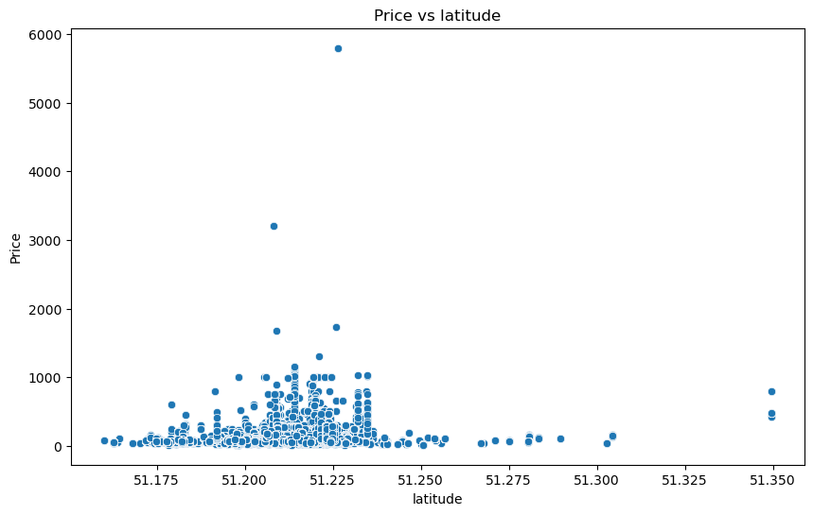
Variable profiling and checking relationships between variables (Task 2):
Plot bivariate relationships using Scatterplot
Analysis by Latitude:
Most of the properties are located between 51.207870 and 51.220905 latitude.
Prices of the properties are high between the latitudes 51.200 and 51.250.

Slide 9
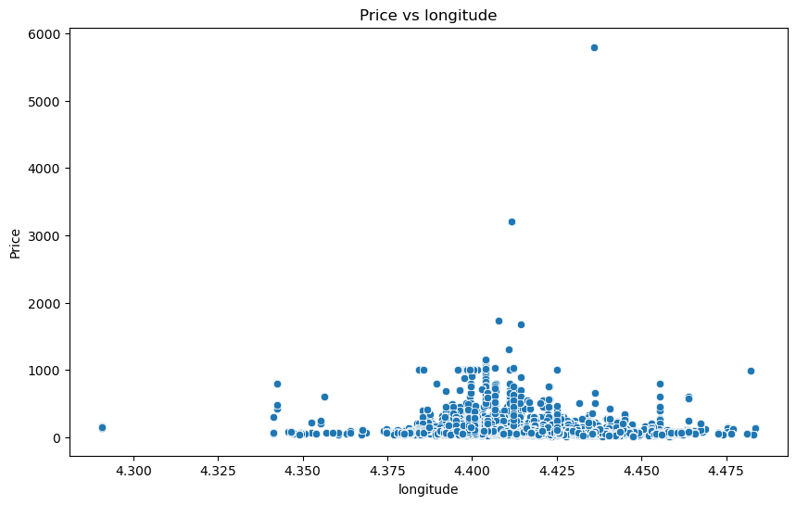
Variable profiling and checking relationships between variables (Task 2):
Analysis by Longitude:
Most of the properties are located between 4.400140 and 4.424660 longitude.
The prices of the properties are relatively high between the longitudes.

Slide 10
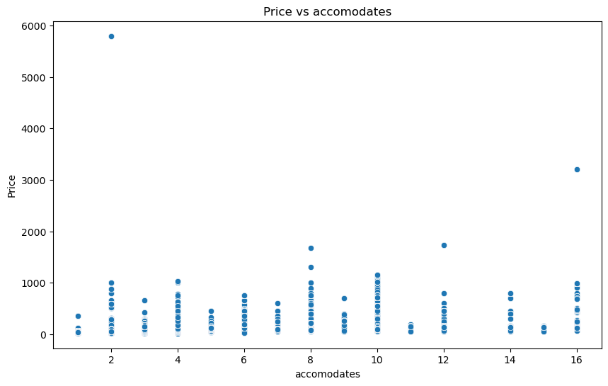
Variable profiling and checking relationships between variables (Task 2):
Analysis by Accommodates:
The accommodation varies from 1 to 16 depending on the property type.
The prices of the even number of accommodations are relatively higher

Slide 11
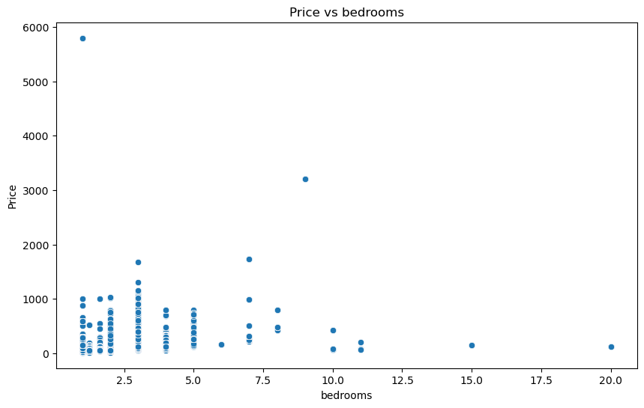
Variable profiling and checking relationships between variables (Task 2):
Analysis by Bedrooms:
Most of the properties offer 1 to 5 bedrooms according to the room type.
The highest price was for a single bedroom.

Slide 12
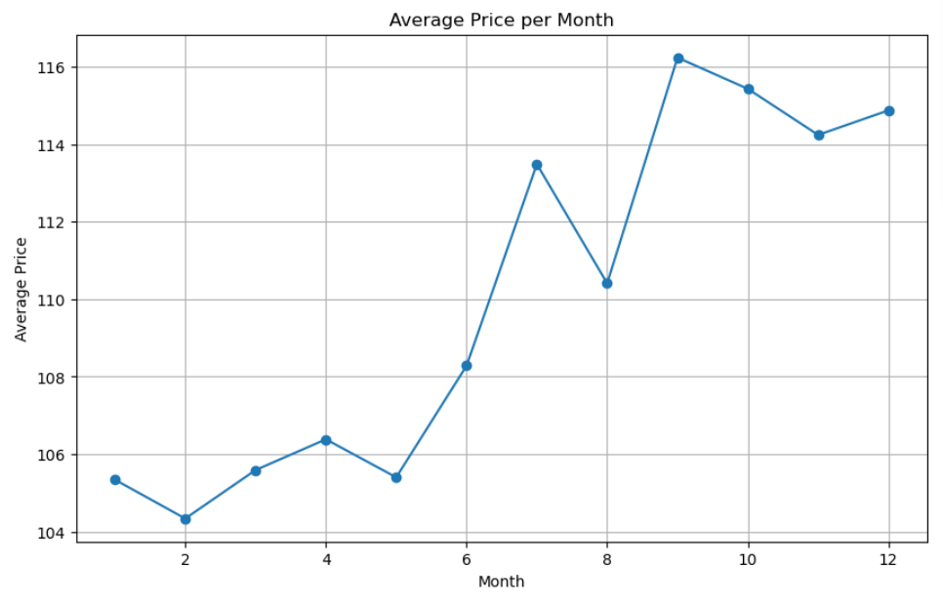
Variable profiling and checking relationships between variables (Task 2):
Analysis using Line Chart on the basis of Change in Average price of Property Monthly
Analysis by Booking Month:
The average price increases in the winters

Slide 13
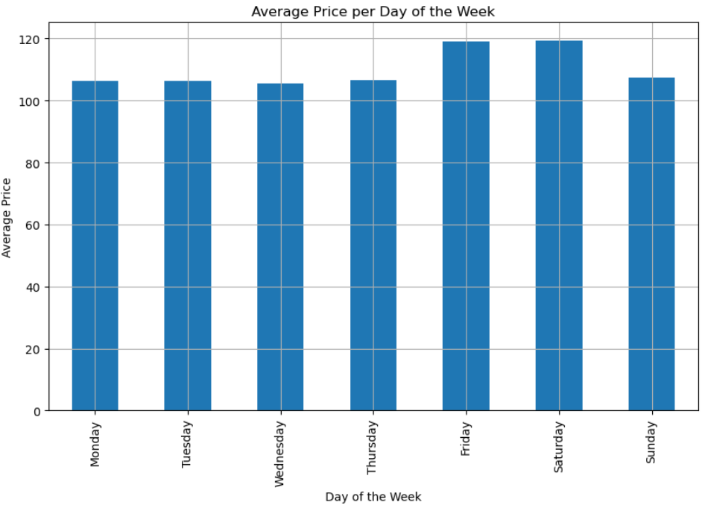
Variable profiling and checking relationships between variables (Task 2):
Analysis on the basis of Change in Average price of Property Day wise
Analysis by Day wise:
The average price increases on Weekends i.e. Friday & Saturday

Slide 14
Variable profiling and checking relationships between variables (Task 2):
Based on the above analysis summarize your findings and list down the transformations you will do on different predictors, remove the variables from further analysis
Analysis by Bathrooms:
Most of the properties offer 1 to 5 bathrooms.
The price increases when the bathroom count reaches 3 and then decreases.
Analysis by Amenities:
The price increases when the property offers more basic amenities that are provided by all the properties.
Analysis by Minimum Nights:
Most of the properties offer a minimum of 5 nights stay.
Analysis by Maximum Nights:
Most of the properties offer a maximum of 813 nights stay.
Analysis by Distance to Airport:
Most properties are located within 4.55 km distance from the airport.
The price is high when the distance is between 3 to 6 km.
Analysis by Distance to Railway:
Most properties are located within 1.73 km distance from the railway station.
The price is high when the distance is between 0 to 2 km.

Slide 15
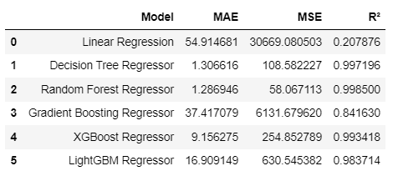
Modelling and insights (Task 2):
Explain your approach on creating train/test/validation splits
Training & Testing: Assuming merged_df is our final preprocessed data frame and 'price' is the target variable
X - predictor/IDV/input [Columns] and y - Target Variable [Price]
Now we create X & y variable
Split the Data into 2 parts, validation set = Training set & Test set by 70 / 30 ratio (%)
By default random_state = 0--> Every time we execute the code data will randomly picked up
random_state = Int value--> Every time the same values will be picked up
Further split temp into validation and test: 15% each
Create a comparison matrix to compare different regression models you've run
We'll create a function to evaluate different regression models and compare their performance using metrics such as Mean Absolute Error (MAE), Mean Squared Error (MSE), and R-squared (R²)

Slide 16
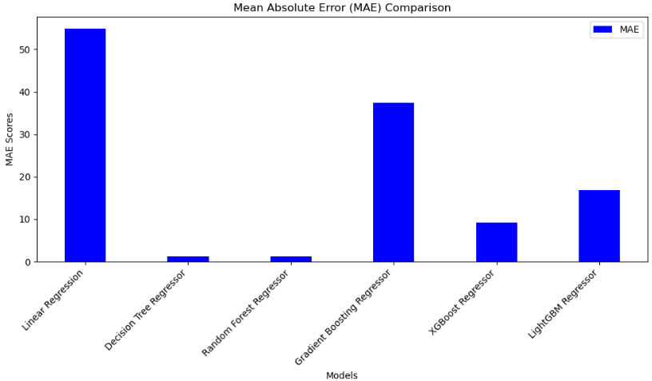
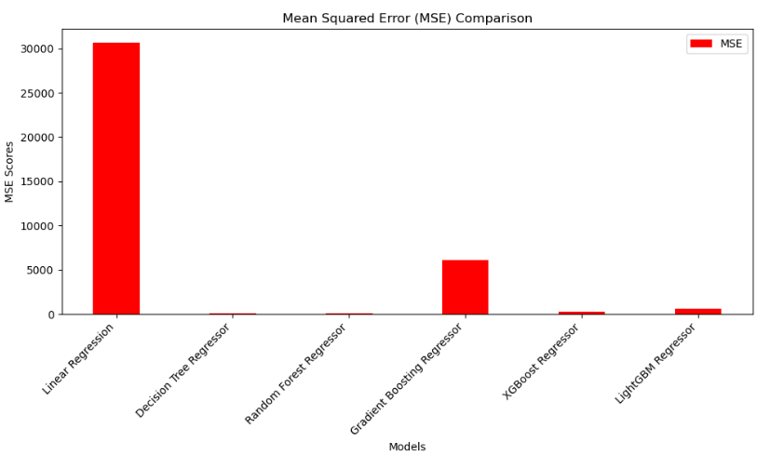
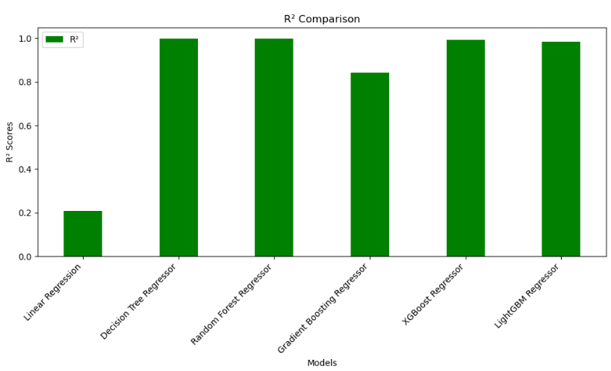
Modelling and insights (Task 2):

Slide 17
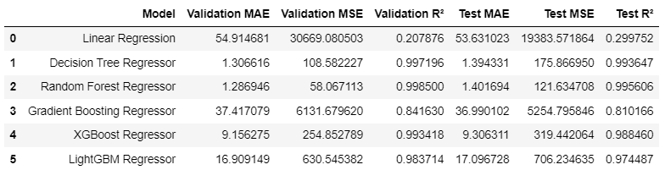
Modelling and insights (Task 2):
Linear regression has the highest MAE and MSE, and the lowest R². This suggests that the data is likely not linear, and linear regression is not able to capture the underlying patterns well.
Decision tree regression performs exceptionally well with very low MAE and MSE, and a high R². However, decision trees can easily overfit, especially if they are not pruned properly. This might indicate overfitting to the training data.
Random forest regression also performs very well with slightly better metrics than the decision tree. Random forests reduce overfitting by averaging multiple decision trees, suggesting a more generalizable model than a single decision tree.
Gradient boosting shows reasonable performance but not as good as the random forest or decision tree. Gradient boosting can also overfit if not tuned properly, but it might also indicate that this method did not capture the patterns as well as the ensemble methods.
XGBoost performs well with low MAE and MSE, and a high R². XGBoost is known for its performance and efficiency, often outperforming other algorithms on structured/tabular data.
LightGBM also shows strong performance but not as good as XGBoost in this case. It is another powerful gradient boosting framework that is typically faster and can handle larger datasets more efficiently.
Testing of all the models:

Slide 18
Modelling and insights (Task 2):
Explain which model you've finalized and why you finalize the model.
Based on the comparison matrix, we will choose the model with the best performance metrics.
The model with the lowest MAE and MSE, and the highest R² is the best.
Best Model: Random Forest Regressor
Test MAE: 1.4016939707545986
Test MSE: 121.63470813256798
Test R²: 0.9956058407503108
Given this, we'll finalize the Random Forest Regressor as the best model.
Explain what are the top 5 most important predictors are and also explain the direction of impact of these top 5 predictors on the response variable.
Top 5 most important predictors:
Feature Importance
property_type_Private room in townhouse 0.274823
property_type_Entire villa 0.139517
accomodates 0.067649
bathroom_number 0.066180
distance_to_railway_station 0.054325
A. To identify the top 5 most important predictors, we can use the feature importance attribute of the finalized model

Slide 19
Modelling and insights (Task 2):
B. Direction of Impact
Explanation of the Finalized Model
Model Finalized: Random Forest Regressor
Reason for Finalization: The Random Forest Regressor had the lowest MAE and MSE, and the highest R² score among all models tested, indicating superior performance in predicting the target variable.
Top 5 Most Important Predictors:
property_type_Private room in townhouse: High importance value, indicates it significantly influences the target variable.
property_type_Entire villa: High importance value, second most influential predictor.
accomodates: Moderate importance value, third most influential.
bathroom_number: Lower importance value, fourth most influential.
distance_to_railway_station: Lowest importance value among the top 5, but still significant.
Direction of Impact: Generally, in tree-based models like Random Forest, higher importance means the feature is more frequently used in the splits and thus has a more significant impact on the predictions. However, the direction (positive or negative) would need further analysis using partial dependence plots or similar techniques.
This approach gives a comprehensive understanding of model performance and the significance of each predictor.

Slide 20
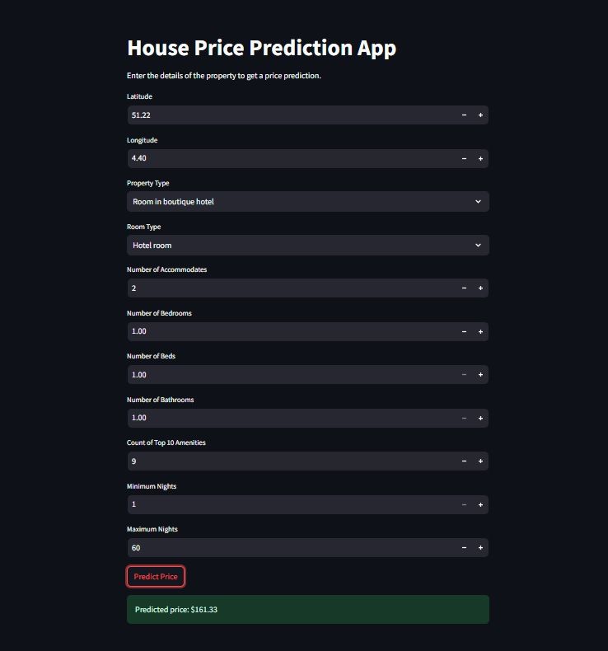
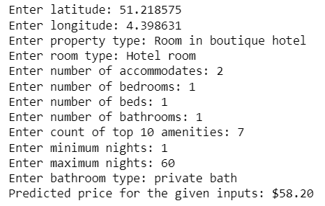
Deployment of Final Model:
Running Deployment through Jupyter and Command Both:

Slide 21
Thank You

